Slide 1
CRUD WEB APPLICATION
Shuaib Hussain
Notes:
Your Name
Here to pitch Himalayas
Our firm’s slogan

Slide 2
Contents
Program Overview
Project
Demonstration
Further Improvements
Notes:
The central idea

Slide 3

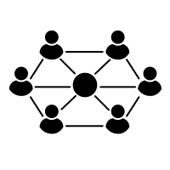


Program Overview
WEEK 1
TRELLO
PM TOOL
AGILE
WEEK 2
NETWORK
FUNDAMENTALS
CLOUD
FUNDAMENTALS
SQL
Notes:
The central idea

Slide 4






Program Overview
WEEK 3
PYTHON
CI/CD
GitHub
PyMySQL
WEEK 4
CLOUD
FUNDAMENTALS
JENKINS
GIT
Notes:
The central idea

Slide 5



Program Overview
WEEK 5
JENKINS
INTEGRATION
GUNICORN
FLASK TESTING
Notes:
The central idea

Slide 6
Project Overview
Introduction
Trello
User Stories
ERDs
Risk Assessment
Tests Log
CI Pipeline
Notes:
The central idea

Slide 7

Project - Book Application
A web application that can add books and reviews was created
Notes:
The central idea

Slide 8
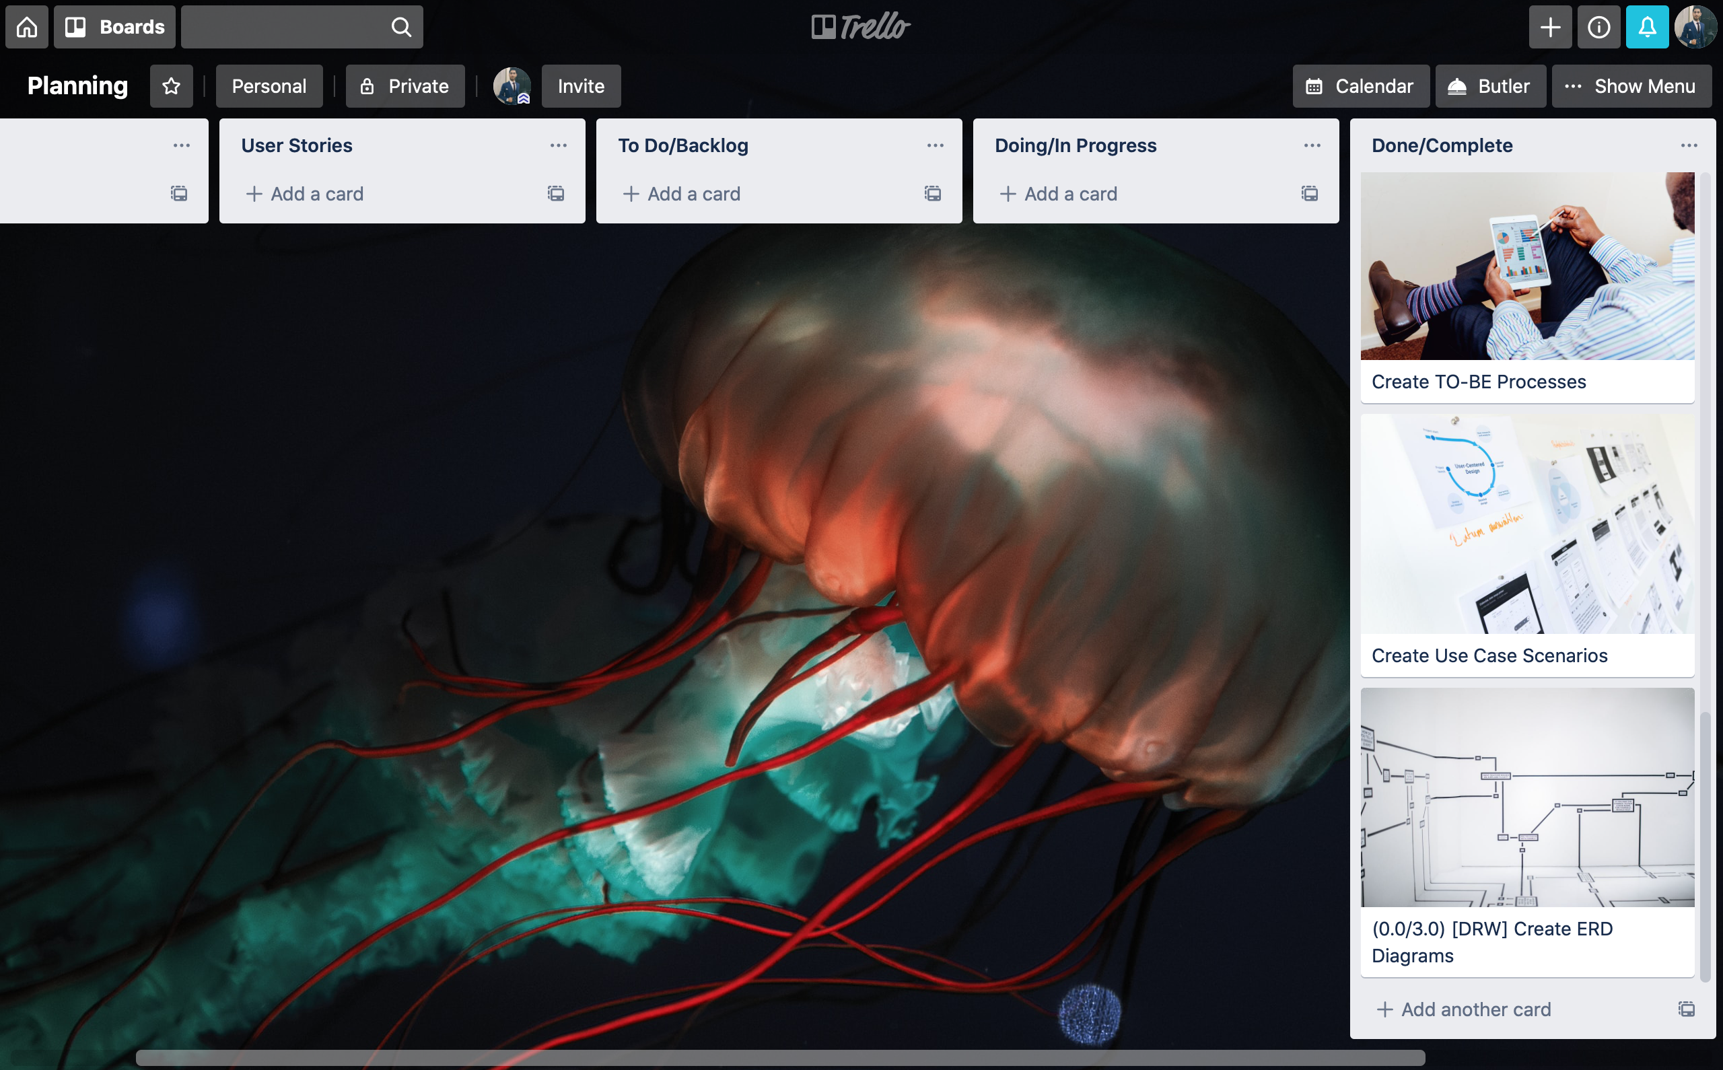

Slide 9
THEME Create a CRUD Application
Create a Web Application that has Book Reviews
I want to be able to access all features of the application
I want to be able to register if I am not a user so that I can use all the features of the application
Sprint backlog
I want to be able to log in so that I can access all the features of the application
I want to be able to change my account details
Product Backlog
I want all my content to have my username attached to it

Slide 10
THEME Create a CRUD Application
Create a Web Application that has Book Reviews
I Want to Read a Review
I Want to Discover New Books
I want to be able to read a list of reviews so that I can select book reviews to read
I want to be able to read a list of books so that I can discover new books
I want to write, edit and delete my reviews so that I share my opinions and make changes
I want to add books that I have written or published so others can discover those books
I want to rate books so that I can share my opinions
I want to see the rating of books so that I can assess how good the book is
I want to be make edit and delete books so that I can makes changes and updates

Slide 11
Login Epic: User Story and Use Case I
I want to be able to register if I am not a user sot that I can use all the features of the application
User visits the website
Go to the website
Easily navigates to the registration section
Select the registration section
User adds details and signs up
Fill in the details and register
User is satisfied with the ease of use

Slide 12
Initial Entity Relationship Diagram

Slide 13
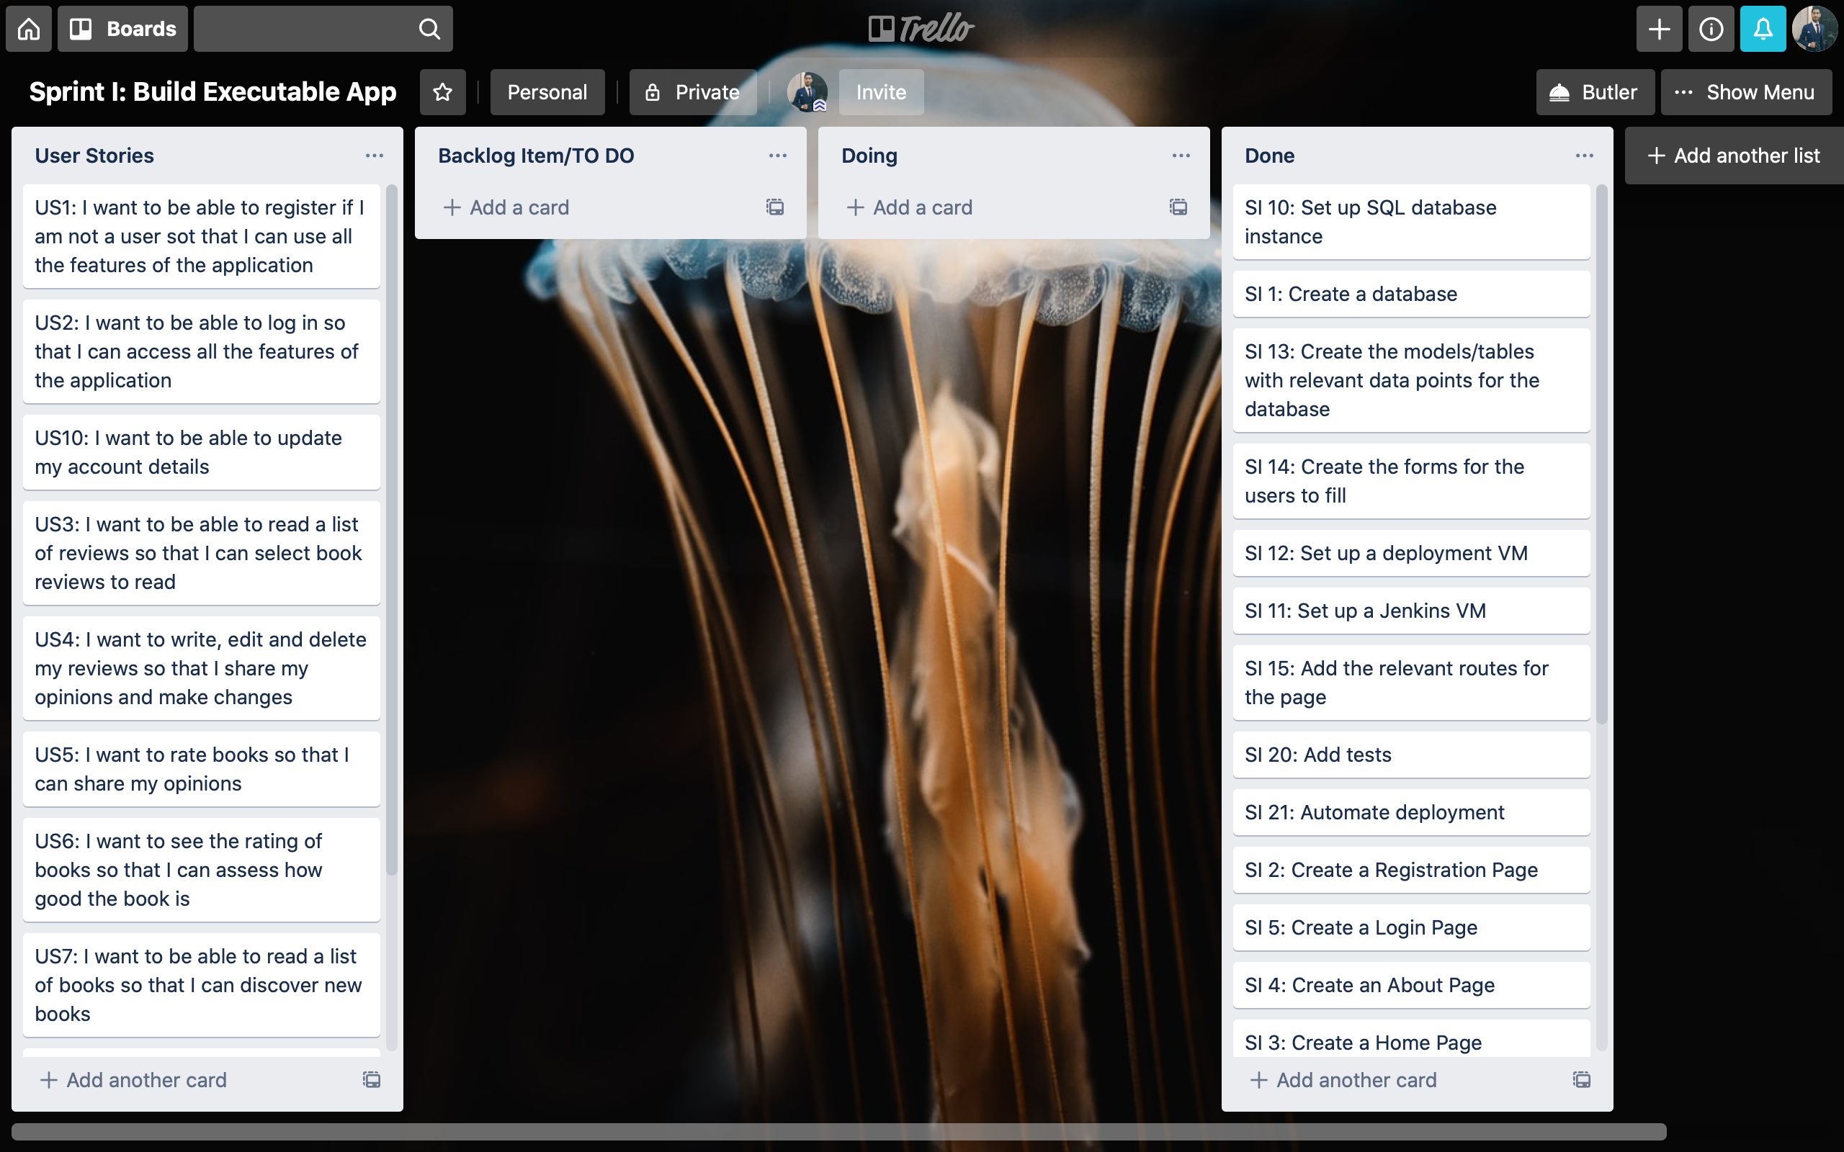

Slide 14
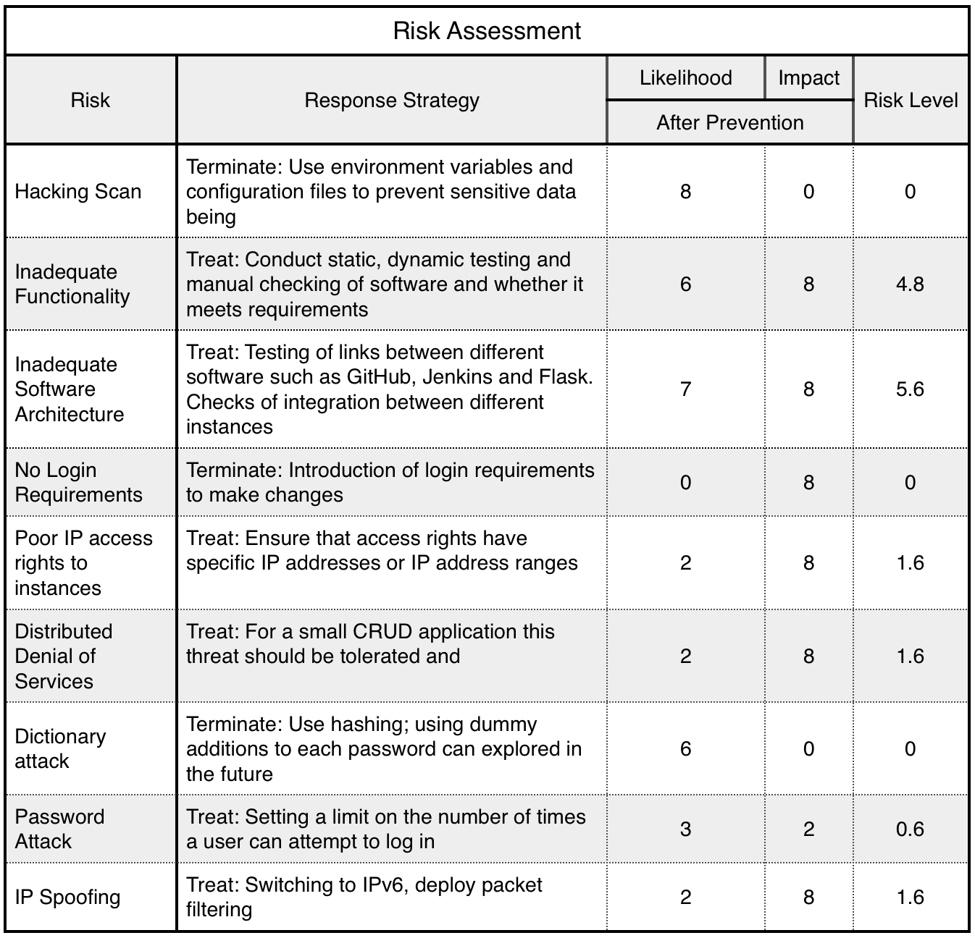
Risk Assessment
Notes:
The central idea

Slide 15
Revised Entity Relationship Diagram
Notes:
The central idea

Slide 16
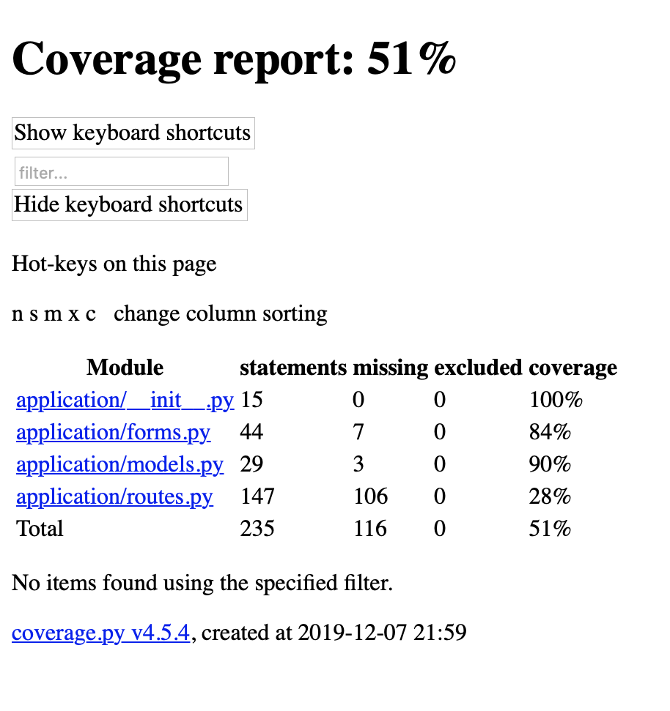
Test Log
Notes:
The central idea

Slide 17
CI Pipeline
Local Source Code
VCS
Git
PM TOOL
Trello
CI SERVER
Jenkins
BUILD SERVER
Python Instance
DATABASE
SQL Instance
Testing Environment
Production Environment

Slide 18
Demonstration - Application
Web Application
http://35.242.162.81:5000/
Notes:
The central idea

Slide 19
Demonstration - Jenkins
Continuous Deployment
http://35.189.235.240:8080/
Notes:
The central idea

Slide 20
Future Improvements
IAM Policies
Search – name, genre
More tests – Including tests after log in
More security – Dummy data
Image of the book
Usernames/Names next to reviews
Notes:
The central idea

Slide 21
Thank You ☺
Notes:
The central idea

